Slide 1
Partnerships
Experience of the Catholic Youth Network for Environmental Sustainability in Africa (CYNESA)
Presented by: Allen Ottaro, Founder and Executive Director
February 4th 2021

Slide 2
Kiswahili proverb: “Umoja ni nguvu, utengano ni udhaifu”. (Unity is strength, division is weakness)

Slide 3
“All of us can cooperate as instruments of God for the care of creation, each according to her own culture, experience involvements and talents.” Pope Francis, Laudato Si’. [14]

Slide 4
Through partnerships, CYNESA is:
Fostering intra and inter-generational dialogue on care for our common home;
Building capacity of young people on Catholic Social Teaching and contemporary environmental issues;
Engaging in a variety of environment and development policy dialogues;
Developing environmental advocacy skills and experience;
Supporting young people to implement environmental projects.

Slide 5
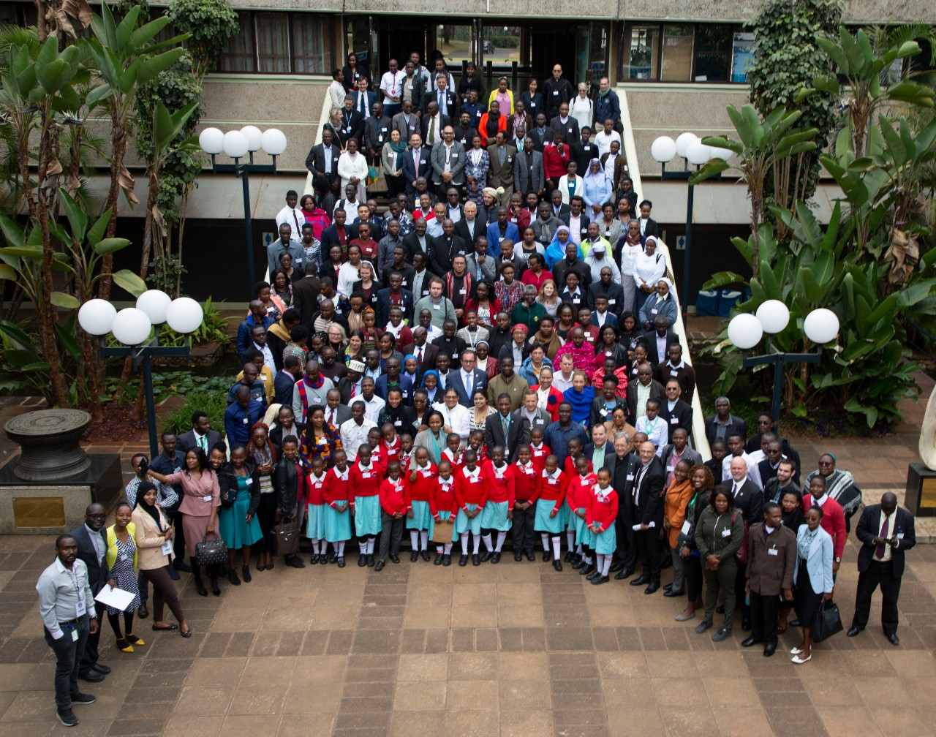
Intra and inter-generational dialogue:
Laudato Si’ Conference in Nairobi, 2019: In partnership with UN Environment, Dicastery for Promoting Integral Human Development and WWF Regional Office for Africa

Slide 6
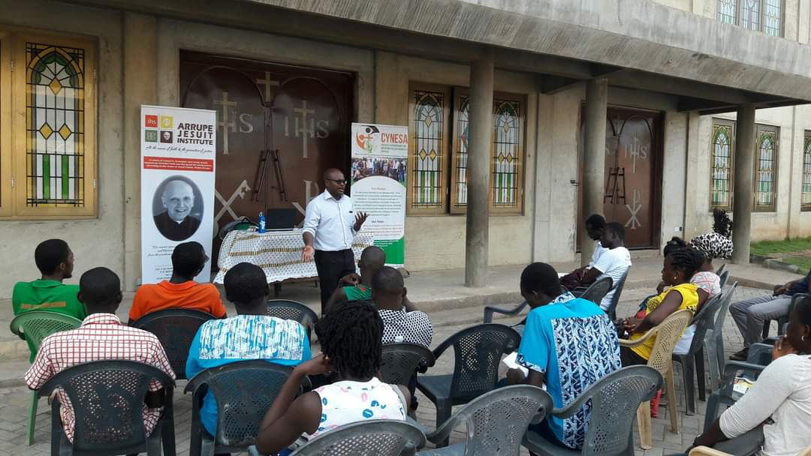
Capacity building
Conversations on climate change in Accra, Ghana; in partnership with the Arrupe Jesuit Institute:

Slide 7
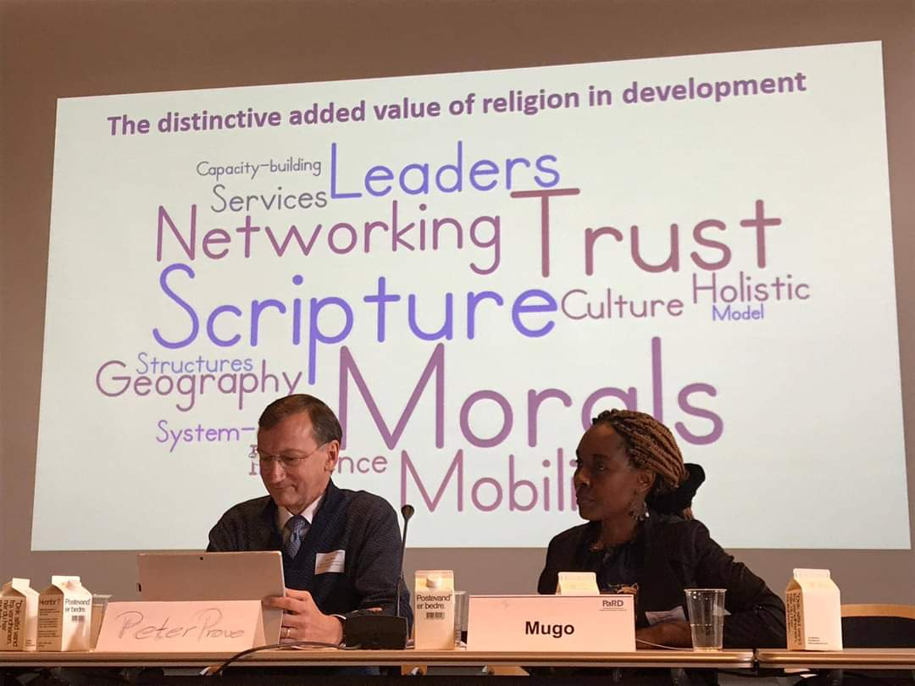
Environmental Policy Dialogues
Meeting of Catholic groups at COP25; GCCM member organizations and partners (REPAM, CIDSE, REBAC, CYNESA)
Meeting of the International Partnership on Religion and Development (PaRD)

Slide 8
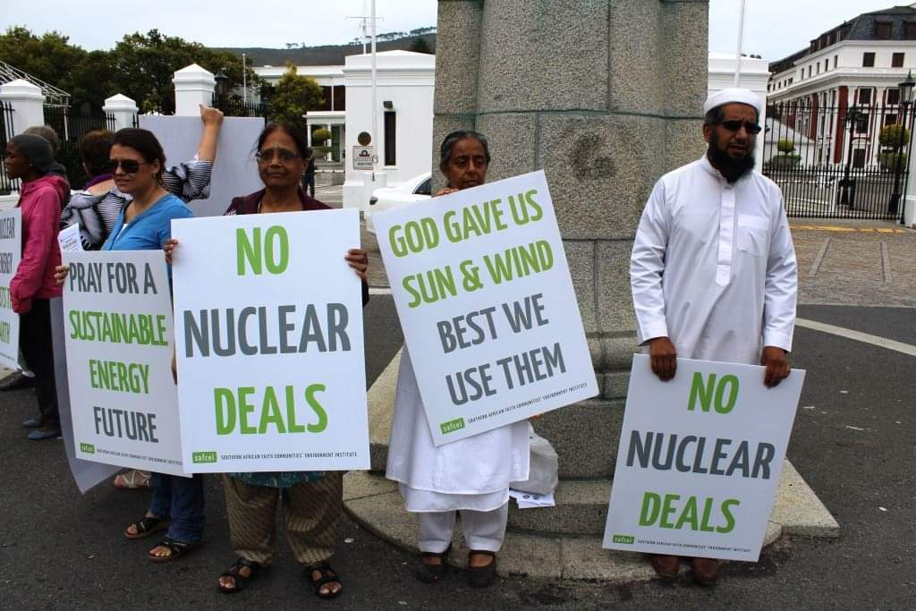
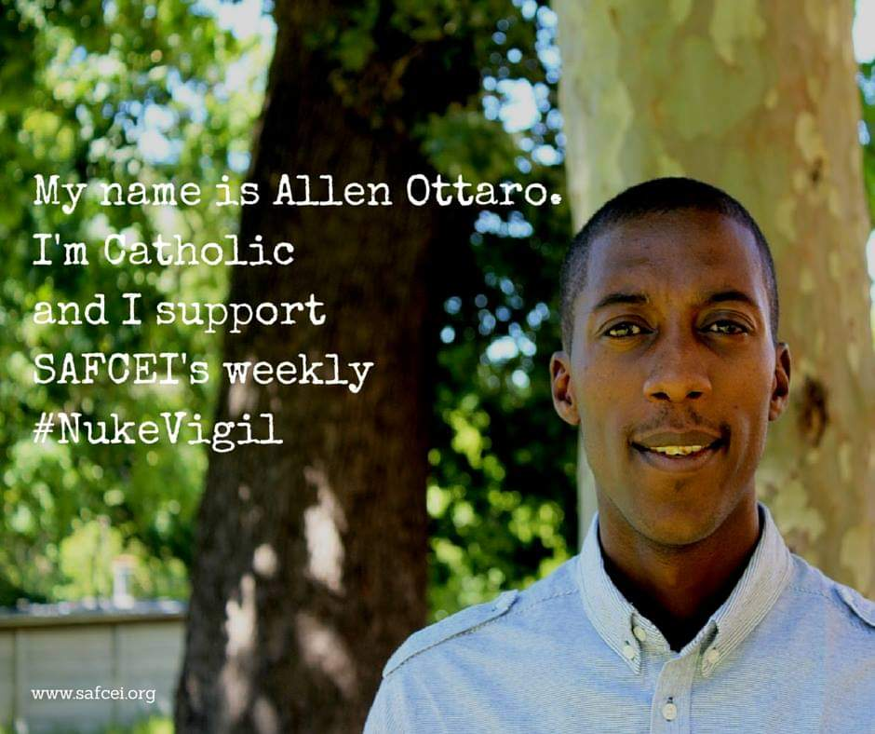
Environmental Advocacy training
Faith Leaders Environmental Advocacy Training (FLEAT), in partnership with the Southern Africa Faith Communities Environment Institute (SAFCEI)
SAFCEI’s Weekly #NukeVigil

Slide 9
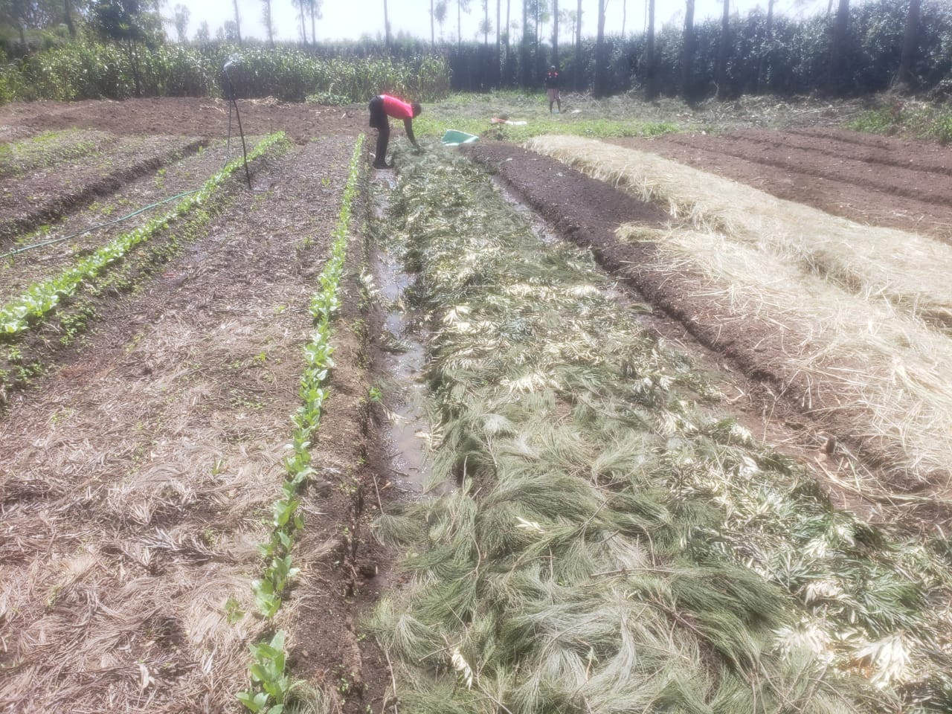
Implementing environmental projects
Demonstration plot on permaculture farming, implemented in the Catholic Diocese of Nakuru, in partnership with Catholic Climate Covenant
CYNESA Cameroon in partnership with a parish in Douala, Cameroon, in a clean up exercise

Slide 10
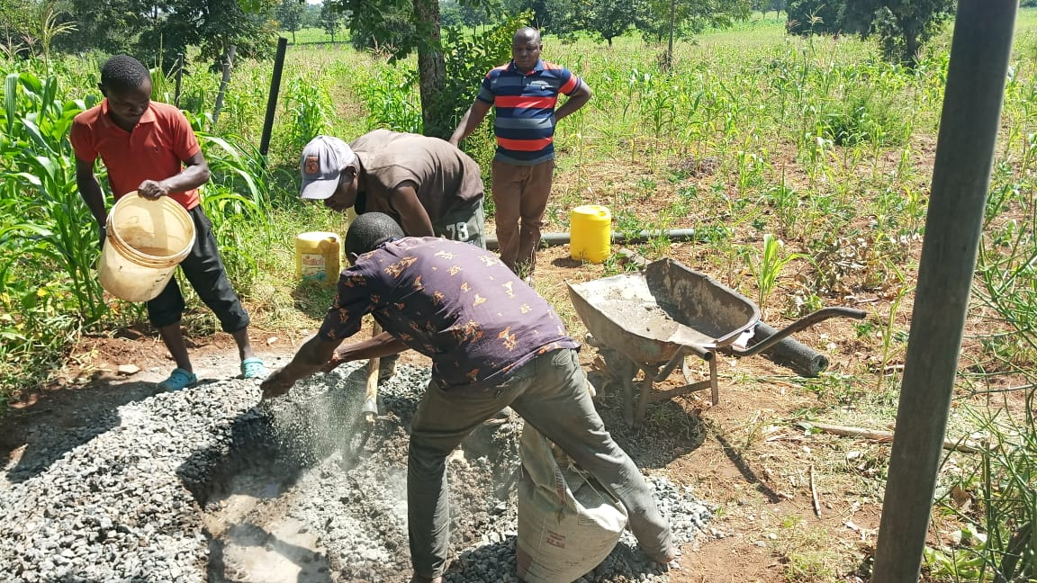
Youth fencing of a plot made available by the Diocese of Murang’a for a joint project between Caritas Murang’a and CYNESA Kenya:

Slide 11
Through partnerships we can overcome any challenge!
Asanteni sana!

